Slide 1
Neural Network Assisted Temporal Reduction for Transmission Expansion Planning

Slide 2
Overview
Problem setting + motivation (2-3)
Methodology
Process overview (1)
Optimization problem (2)
Neural network (2)
Line benefits (1)
Clustering process (1)
Results thus far
Neural network output (6)
Line benefits (2)
Future tasks (1)

Slide 3
Problem setting
Research background
Transmission expansion planning (TEP) is based on calculating Optimal Power Flow (OPF)
OPF problem is computationally heavy, especially AC formulations
Temporal aggregation for problem size reduction
Clustering for representative periods
How to find representative days for a spatially resolved system?
Ex-post clustering
Multitude of OPFs have to be solved for Transmission Expansion Planning
Multiple investment candidates (lines)
Multiple discrete investment quantities
Weather year sensitivity
Might still be computationally intensive
Literature shows that ML methods can accurately approximate OPF results very fast

Slide 4
Background: transmission expansion planning
TEP is based on calculating the demanding OPF problem
Increasing share of renewables → Rising variability in system operation
Temporal reduction techniques → Representative periods
Capture variability in system operating conditions (weather)
Accurately represent physical constraints of network
Many demanding OPFS
Computational tractability
Temporal reduction
Representative periods

Slide 5
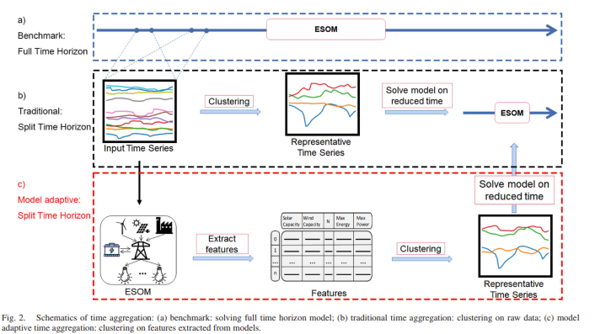
Motivation: finding representative periods
How to find representative periods for a spatially resolved system with complex interactions?
→ Ex-post clustering = use simplified model to extract features relevant for your problem and cluster on those

Slide 6
Motivation: finding representative periods
Proposed feature for clustering for TEP: Investment benefit of individual lines
Many possible candidates
Many discrete values for expansion
Weather year sensitivity
A multitude of OPFs to be solved
Replace part of the calculation with a machine-learning algorithm

Slide 7
Process overview
Benchmark:
Full time horizon
Input Data
ESOM
Traditional:
Split time horizon
Input Time Series
Clustering
Method
Representative Time Series
ESOM
Relaxed ESOM
Features
Clustering
Method
Representative Time Series
ESOM
Based in Costs:
Split time horizon
(ANN + Kmedoids)
Clustering
Method
Investment Benefit
Proposal:
Split time horizon
ANN: Cost Estimator
Features
(Investment benefit)
Representative Time Series
ESOM
*ESOM: Energy System Optimization Model
**ANN: Artificial Neural Network

Slide 8
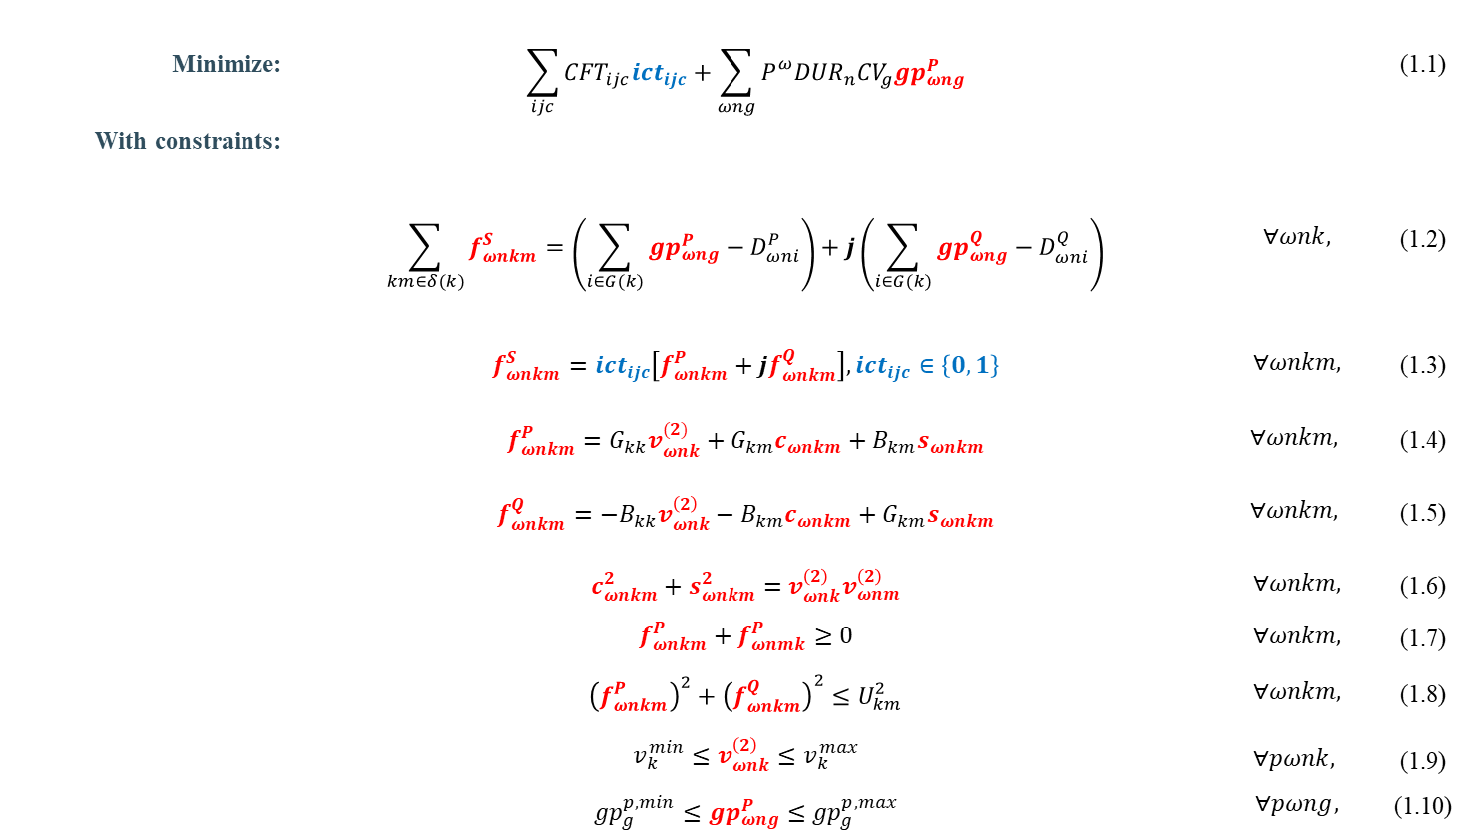
ESOM: Transmission Expansion Planning considering AC-OPF
Minimize: | $$\sum_{ijc}{{CFT}_{ijc}{ict}_{ijc}}+\sum_{ωng}{P_{}^{ω}{DUR}_{n}{CV}_{g}{gp}_{ωng}^{P}}$$ |  | (1.1)
With constraints:
 | $$\sum_{km∈δ(k)}{f_{ωnkm}^{S}}=\left(\sum_{i∈G(k)}{{gp}_{ωng}^{P}−D_{ωni}^{P}}\right)+j\left(\sum_{i∈G(k)}{{gp}_{ωng}^{Q}−D_{ωni}^{Q}}\right)$$ | $$∀ωnk,$$ | (1.2)
 | $$f_{ωnkm}^{S}={ict}_{ijc}\left[f_{ωnkm}^{P}+jf_{ωnkm}^{Q}\right],{ict}_{ijc}∈\left\{0,1\right\}$$ | $$∀ωnkm,$$ | (1.3)
 | $$f_{ωnkm}^{P}=G_{kk}v_{ωnk}^{(2)}+G_{km}c_{ωnkm}+B_{km}s_{ωnkm}$$ | $$∀ωnkm,$$ | (1.4)
 | $$f_{ωnkm}^{Q}=−B_{kk}v_{ωnk}^{\left(2\right)}−B_{km}c_{ωnkm}+G_{km}s_{ωnkm}$$ | $$∀ωnkm,$$ | (1.5)
 | $$c_{ωnkm}^{2}+s_{ωnkm}^{2}=v_{ωnk}^{\left(2\right)}v_{ωnm}^{\left(2\right)}$$ | $$∀ωnkm,$$ | (1.6)
 | $$f_{ωnkm}^{P}+f_{ωnmk}^{P}≥0$$ | $$∀ωnkm,$$ | (1.7)
 | $${\left(f_{ωnkm}^{P}\right)}^{2}+{\left(f_{ωnkm}^{Q}\right)}^{2}≤U_{km}^{2}$$ | $$∀ωnkm,$$ | (1.8)
 | $$v_{k}^{min}≤v_{ωnk}^{\left(2\right)}≤v_{k}^{max}$$ $${gp}_{g}^{p,min}≤{gp}_{ωng}^{P}≤{gp}_{g}^{p,max}$$ | $$∀pωnk,$$ $$∀pωng,$$ | (1.9) (1.10)
Non-convex
Getting a MILP model by applying:
Disjunctive constraints
Piecewise functions
McCormick envelopes

Slide 9
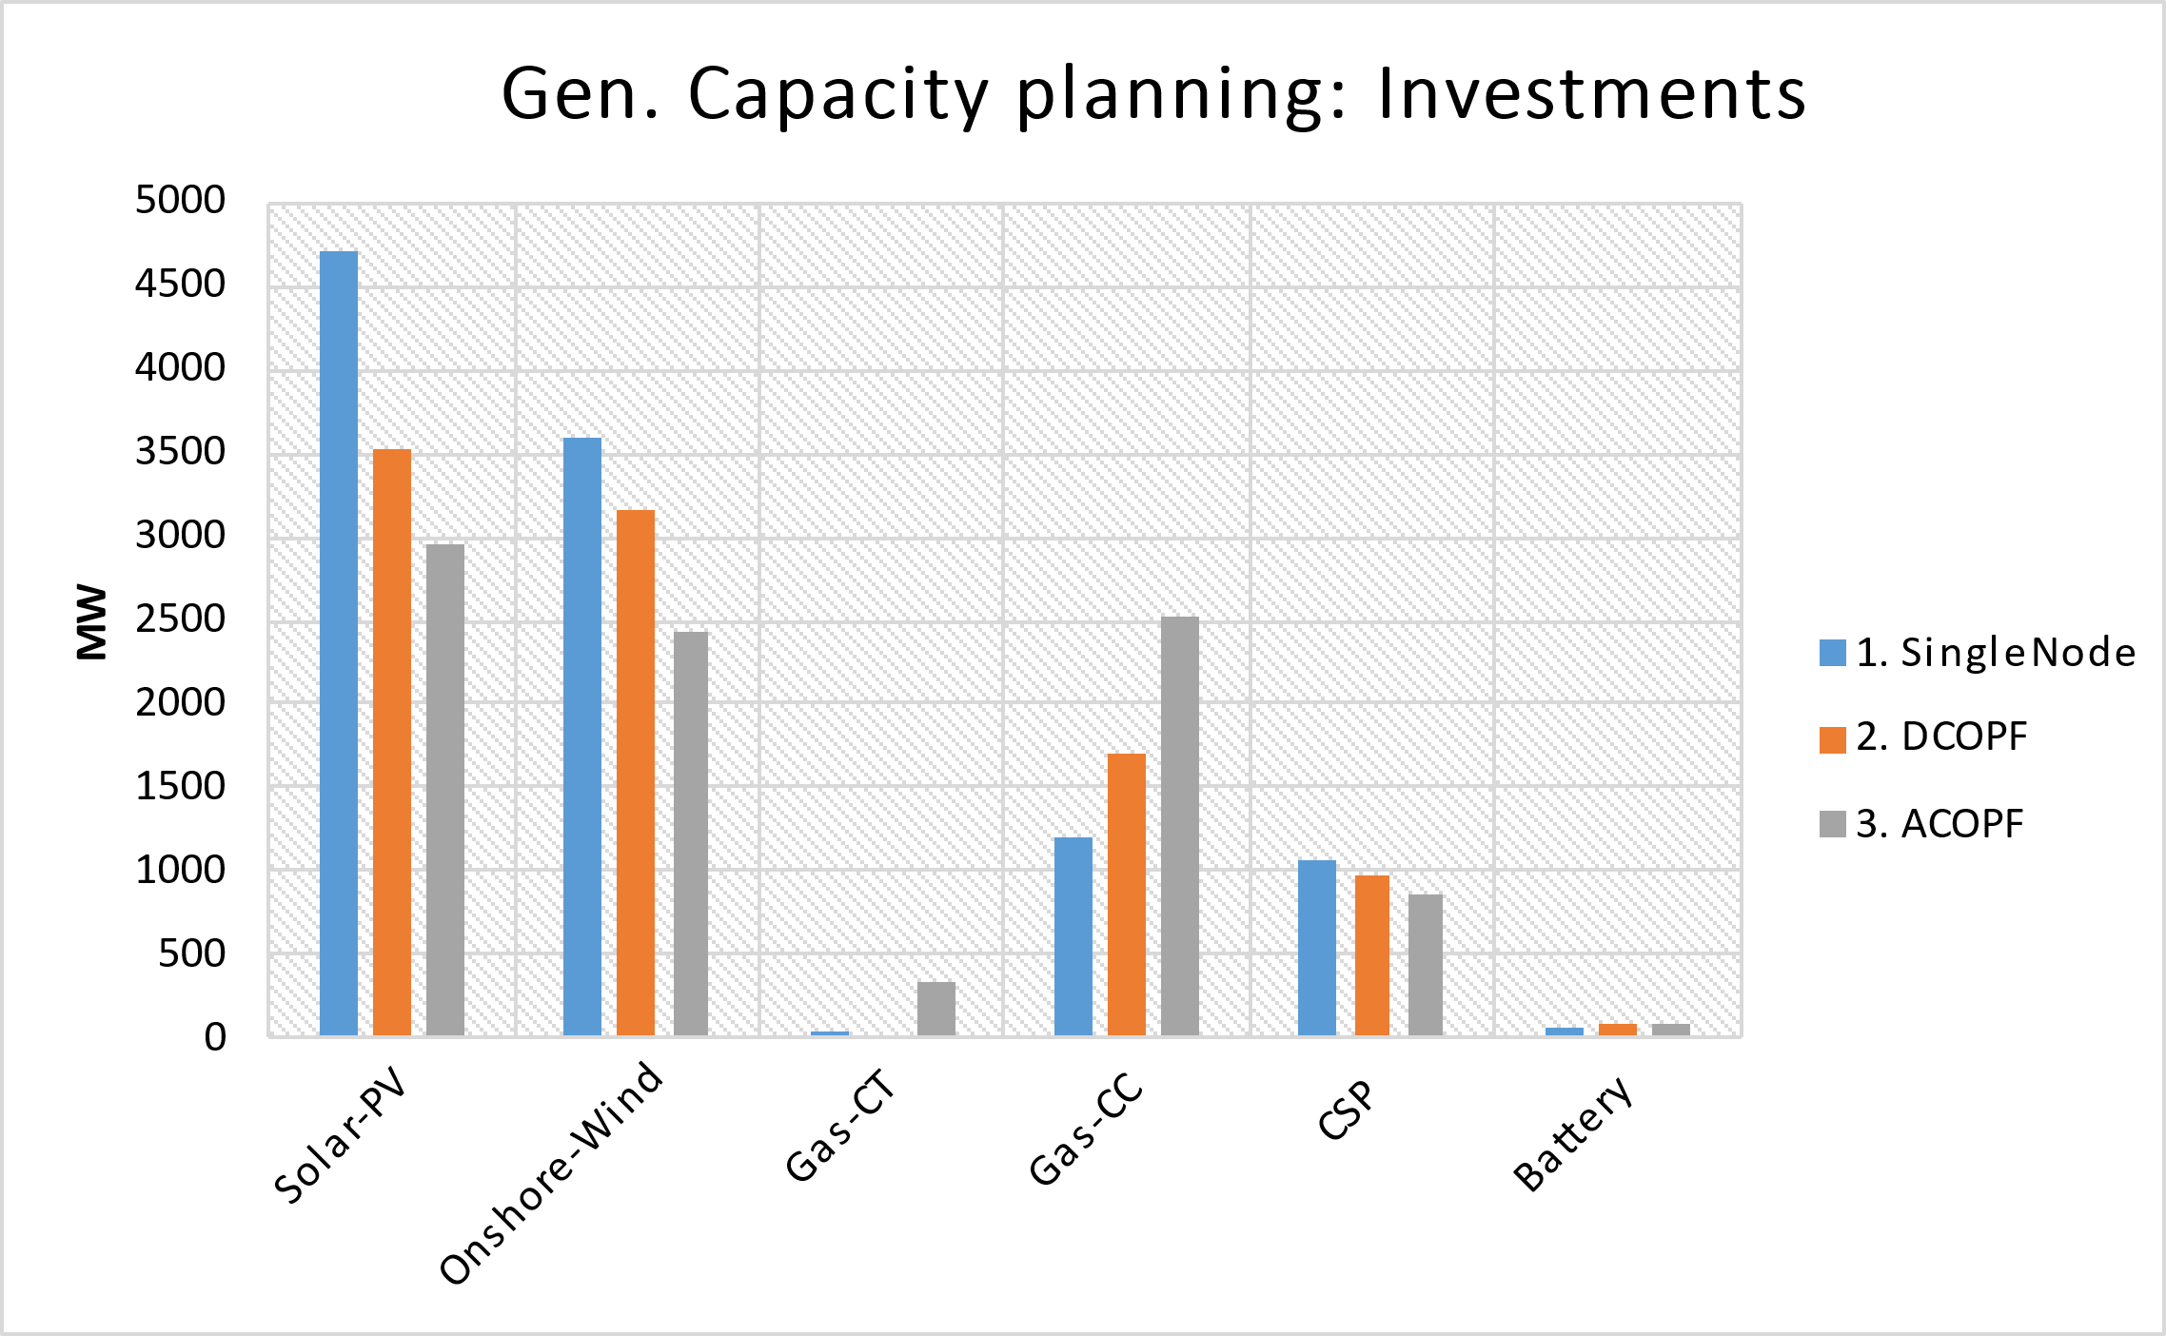
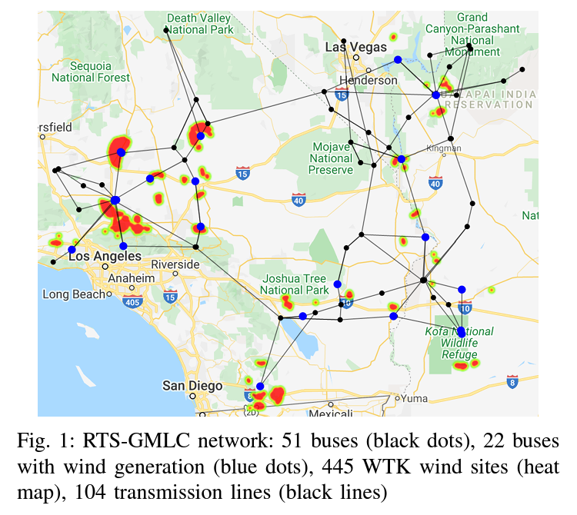
ESOM: Why considering AC-OPF?
Disadvantages:
ACOPF’s problem size is ~4x-6x of the DCOPF
Computation burden: ~6x-10x
Implications on the Gen. capacity planning
Implications on the transmission expansion
RTS-GMLC
Source: Scenario Creation and Power Conditioning Strategies for
Operating Power Grids with Two-Stage Stochastic Economic Dispatch
Link: https://www.nrel.gov/docs/fy21osti/75363.pdf

Slide 10
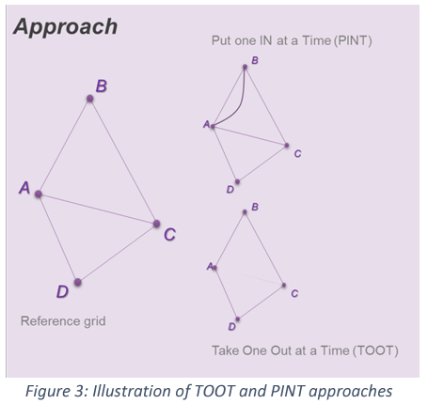
Line Benefits
The PINT and TOOT
Investment Benefit
ANN: Cost Estimator
Sequence per candidate asset and hour
PINT (or TOOT)
Reference grid
ANN Cost
Estimator
ANN Cost
Estimator
Line Benefit Methods:
The Put IN one at the Time (PINT)
The Take Out One at the Time (TOOT)
Shapley value
Aumann-shapley value
Benefit 1 (Benefit 2) =
Reference grid – PINT
(TOOT – Reference grid)
[source] ENTSO-E: Guideline for Cost Benefit Analysis of Grid Development Projects
Link: https://eepublicdownloads.entsoe.eu/clean-documents/tyndp-documents/Cost%20Benefit%20Analysis/191023_CBA3_Draft%20for%20consultation.pdf

Slide 11
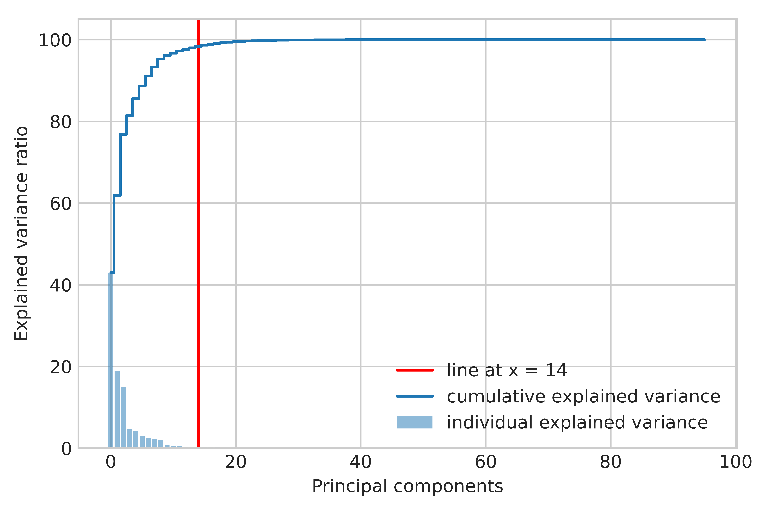
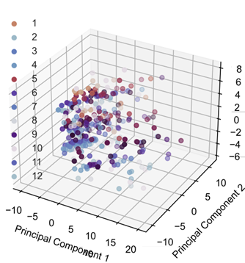
Clustering process
Dimensionality reduction
Optimal number of representatives/clusters
Selection/aggregation using K-medoids
Dimensionality reduction using PCA
Optimal number of clusters:
Elbow method

Slide 12
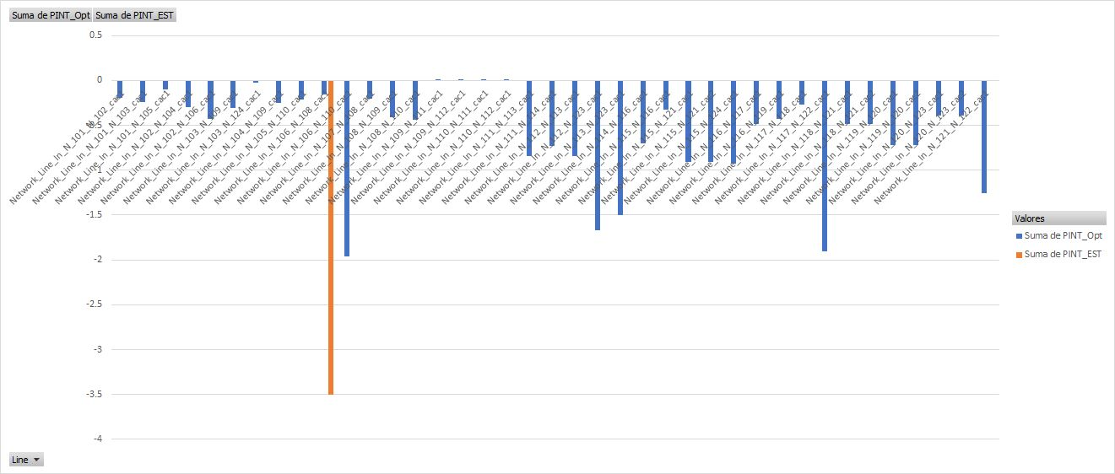
Line Benefits: Preliminary results

Slide 13
